Slide 1
Diabetes mellitus in pregnancy-How we manage
Dr. Carmeline Motha
Consultant physician & senior lecturer,
Department of Obstetrics & Gynaecology, Faculty of Medicine, Ragama

Slide 2

Gestational diabetes mellitus

Slide 3

Screening test
Universal screening
At 24-28 weeks 75g oral glucose challenge test
FBS≥ 92 mg/dl
1 hour post glucose load ≥ 180 mg/dl
2 hr post glucose value > 153 mg/dl

Slide 4
Attain Euglycaemia
Life style measures
Medical nutrition therapy
Regular exercise

Slide 5
Medical nutrition therapy
Aims
Achievement & maintenance of normoglycaemia
Appropriate gestational weight gain
Avoidance of ketosis

Slide 6
Medical nutrition therapy
Avoid refined sugars
Redistribute carbohydrate throughout the day
Frequent small meals

Slide 7
Exercise
Regular exercise
Brisk walk for 20 min 5 days a week

Slide 8


Slide 9
Attain euglycaemia
If mild hyperglycaemia- life style measures

Slide 10
Blood sugar monitoring
How?
6 point blood sugar series
4 point blood sugar series
Target range?
FBS-65-105mg/dl
PPBS
1 hr <140mg/dl
2hr <115mg/dl
MSBG is encouraged

Slide 11
Medications
First line- insulin

Slide 12
Insulin regimes
Basal bolus multidose injection:
Actrapid (or Novorapid/Humalog) three times a day before meals
basal insulin 6 to 10 units at 10 p.m.
Twice daily pre-mix regime :
Human Mixtard 30, Humulin M3
2/3 of total dose before breakfast
1/3 of total dose before evening meal

Slide 13
Guide to calculating the dose of insulin
Total insulin dose during pregnancy (Starting dose)
Gestational age (week) | Total Daily Insulin
Week 1-18 | 0.7 U/kg actual body weight
Weeks 18-26 | 0.8 U/kg actual body weight
Weeks 26-36 | 0.9 U/kg actual body weight
Weeks 36-40 | 1.0 U/kg actual body weight

Slide 14
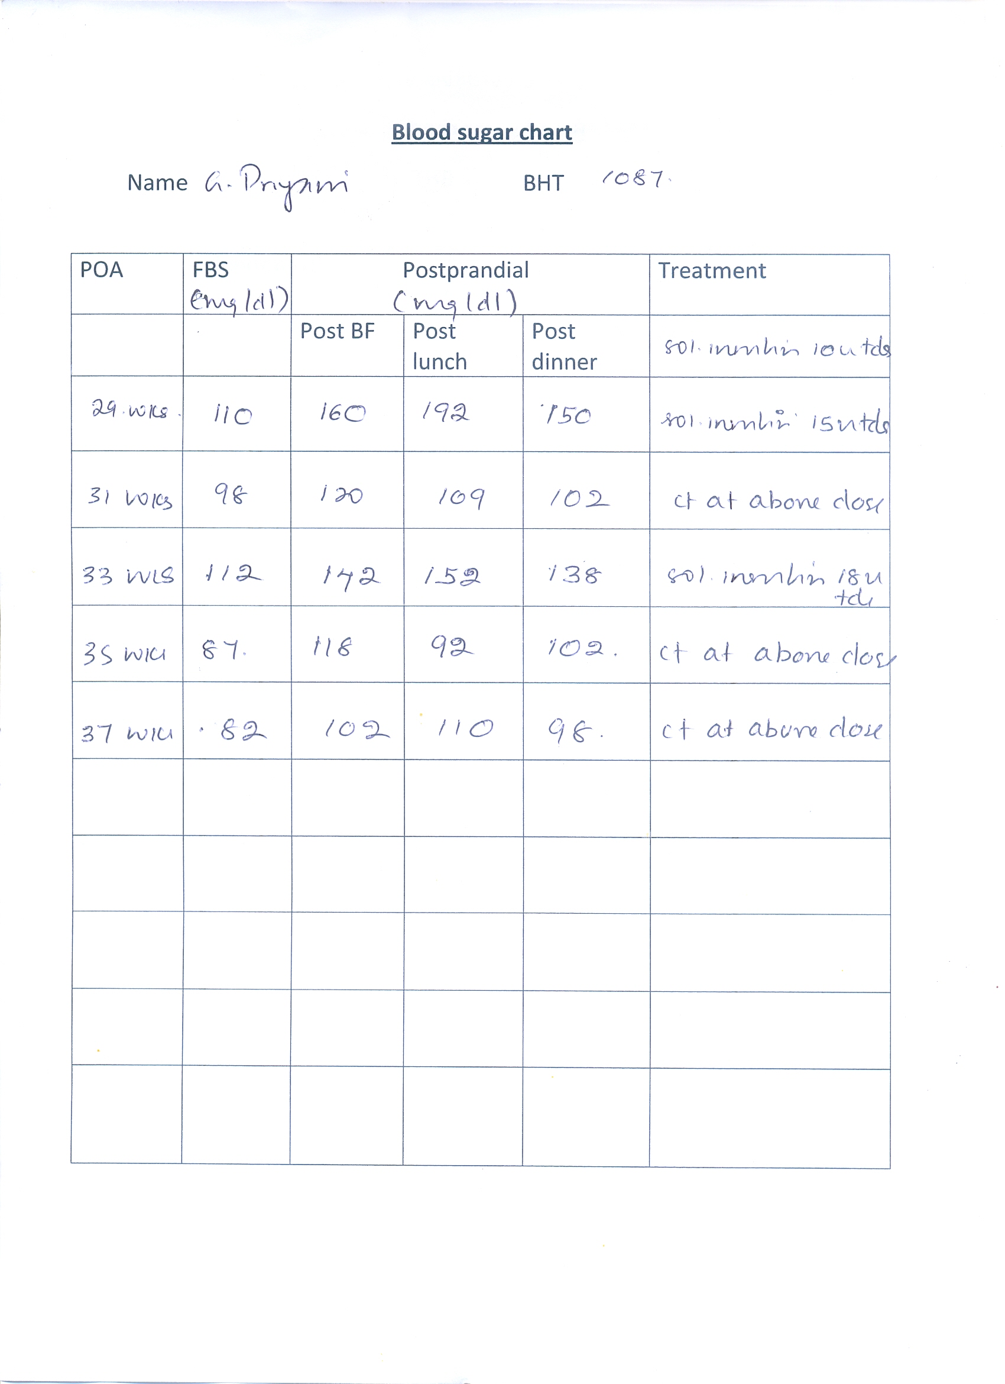

Slide 15
Medications
Second line – metformin
Maximum dose of 2g per day
Monitor blood sugar 10-14 days after modifications in dosage

Slide 16
Antenatal management
Dating scan
Frequent antenatal visits
Treatment escalation during steroid therapy
Fetal growth scan from 28 weeks onwards
Fetal abdominal circumferance > 70%
intensify /commence treatment

Slide 17
Management of labour

Slide 18
Delivery
Planned delivery
Omit the morning dose of insulin
Perform a CBS at the onset of established labour
Spontaneous delivery
CBS at the onset of established labour
CBS >126 mg/dl – insulin dextrose infusion is commenced

Slide 19
Delivery
Insulin sliding scale for use during labour:
Add 50 units of soluble insulin into 50 ml of 0.9% saline and infuse according to the sliding scale
Add 20mmol of KCL into 1 litre of 5% dextrose solution and infuse at a rate of 100ml/hr

Slide 20
Insulin sliding scale for use during labour
Current total daily insulin dose | Up to 40 units / day | 41-60 units / day | 61-90 units / day | >91 units / day
Capillary Glucose (mg/dl) | Infusion rate (units / hr) | Infusion rate (units / hr) | Infusion rate (units / hr) | Infusion rate (units / hr)
0-54 | 0 | 0 | 0 | 0
55- 125 | 1.0 | 1.5 | 2.0 | 2.0
126-160 | 1.5 | 2.0 | 3.0 | 4.0
161-195 | 2.0 | 3.0 | 4.0 | 5.0
196 - 270 | 3.0 | 4.0 | 5.0 | 6.0
>270 | Exclude diabetic ketoacidosis | Exclude diabetic ketoacidosis | Exclude diabetic ketoacidosis | Exclude diabetic ketoacidosis

Slide 21
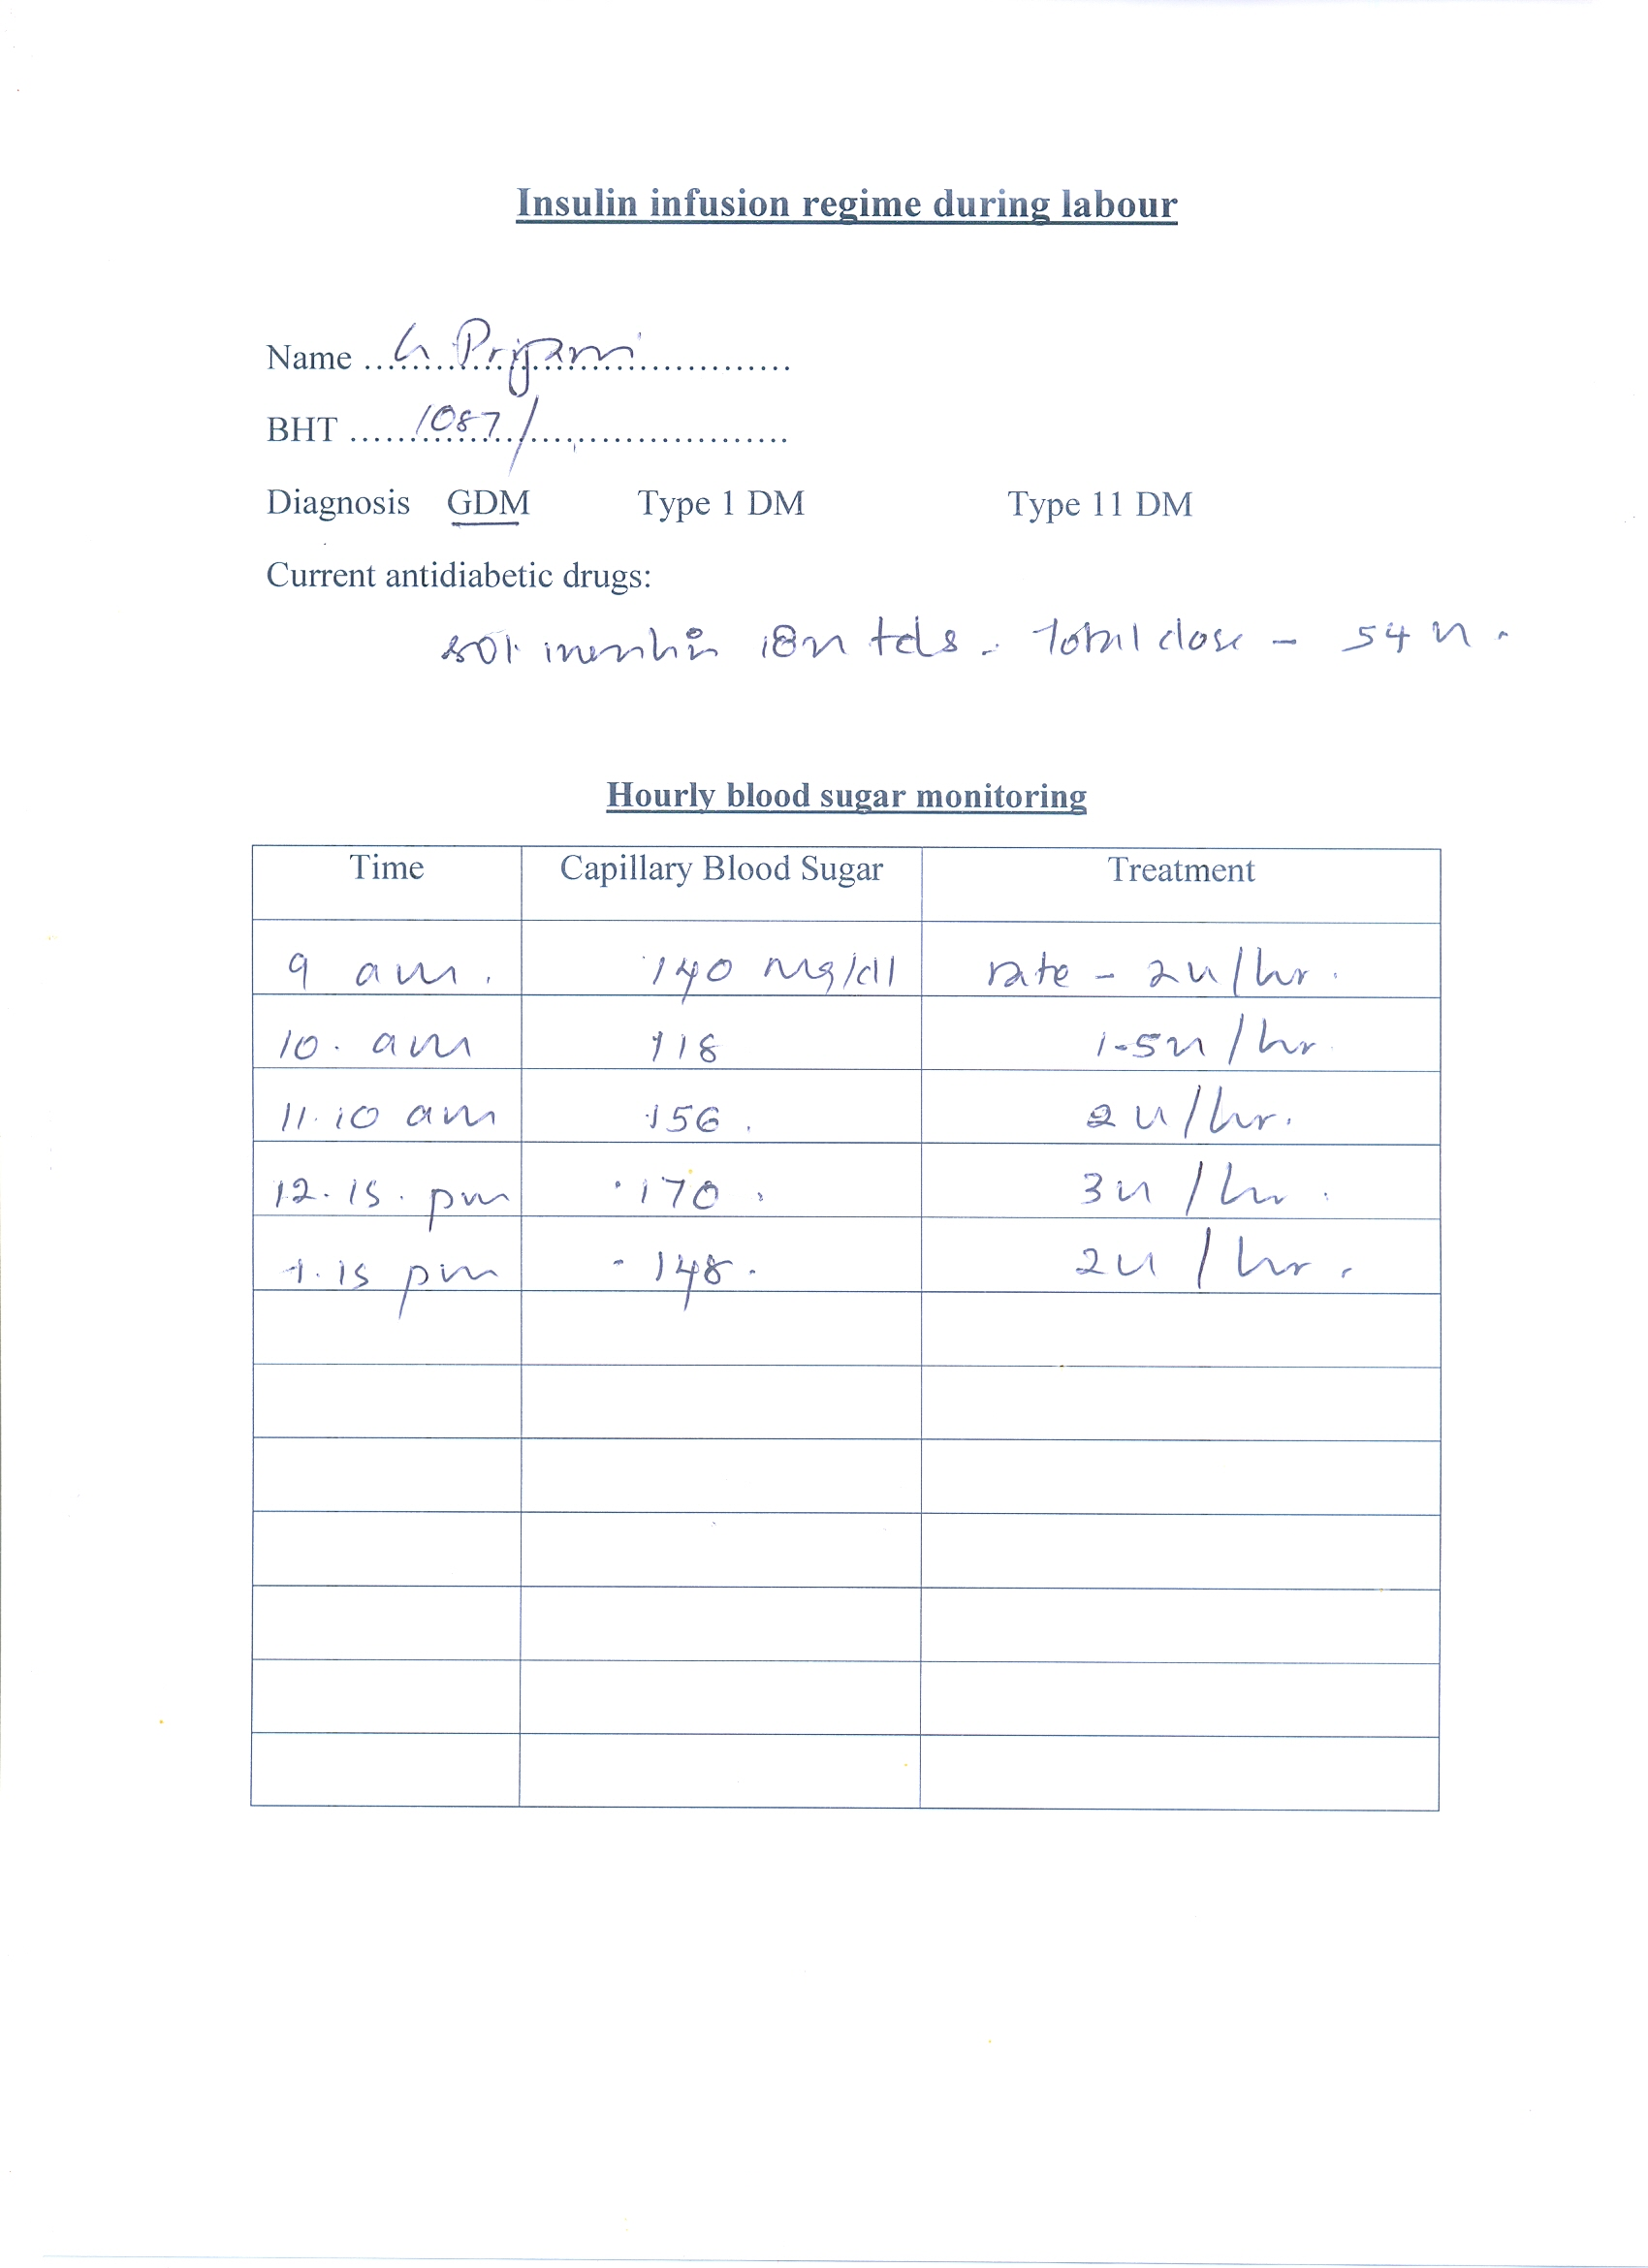

Slide 22
Postpartum management
Stop hypoglycaemic agents
FBS & PPBS in 48 hours
Breast feeding

Slide 23
6 weeks postpartum review
75g OGTT
IF FBS< 126 mg/dl and 2 hour value <200 mg/dl
-reassure that diagnosis was GDM
-yearly OGTT or PPBS
-life style measures

Slide 24

Pre-existing diabetes mellitus

Slide 25

Preconception care

Slide 26


Slide 27
Pre conception care
HbA1C< 6.1%
Retinopathy screen
Renal assessment
BMI>25Kg/m2
Folic acid 5 mg/d
Review medications

Slide 28
Antenatal management
Dating scan
Aspirin 75 mg daily from 12 weeks onwards
Fetal anomaly scan 18-20 weeks
SMBG encouraged
Fetal growth scan
Retinopathy screen at 28 weeks

Slide 29
Delivery
Type I DM – GIK regime
Type 11 DM – GIK regime based on blood sugar levels

Slide 30
Postpartum care
Type 11 DM - Pre-pregnancy hypoglycaemic regime
Type 1 DM - 60-70% of the insulin dose
Early breast feeding
Snacks encouraged
Refer to medical care
Contraceptive advice

Slide 31
Diabetic ketoacidosis
Fixed dose insulin infusion regime
Ketosis is common in pregnancy
ketonaemia or acidaemia should be demonstrated
Poor uteroplacental blood flow and fetal acidosis

Slide 32

Multidisciplinary approach

